Slide 1
Bridge Street
Lisburn

Slide 2
The Lisburn Coat of Arms
This is the coat of arms of Lisburn.
It links together the key elements that have made Lisburn the town that it is today.
This includes reference to the two fires that destroyed the old settlement of Lisnagarvey.

Slide 3
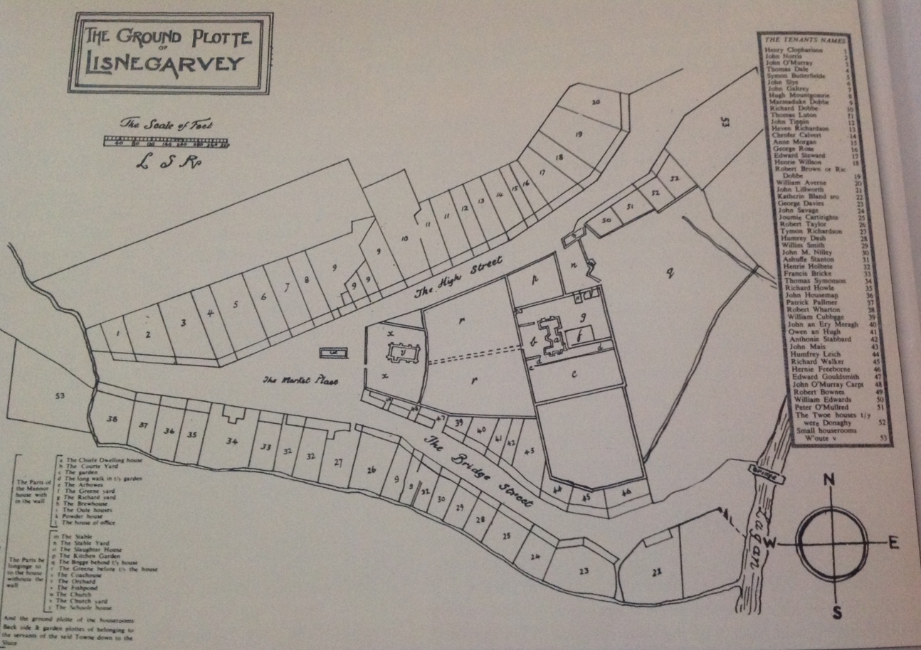
The Settlement of Lisnagarvey
This is a map showing the original settlement of Lisnagarvey.
Bridge Street can clearly be seen as one of the first main roads in the town.

Slide 4
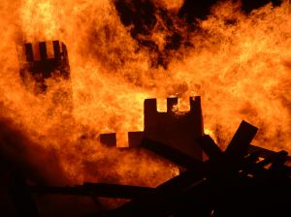
The Fires of Lisnagarvey
Lisnagarvey was burnt by a fire during the Great Rebellion of 1641. The entire settlement was turned to ash within. a matter of hours. It was then that the name of Lisnagarvey began to change to that of ‘Lisburn’
In 1707, a great fire halted the growth of Lisburn. Once again it was reduced to ashes, this time even the great castle fell to the flames. The castle was never rebuilt.

Slide 5
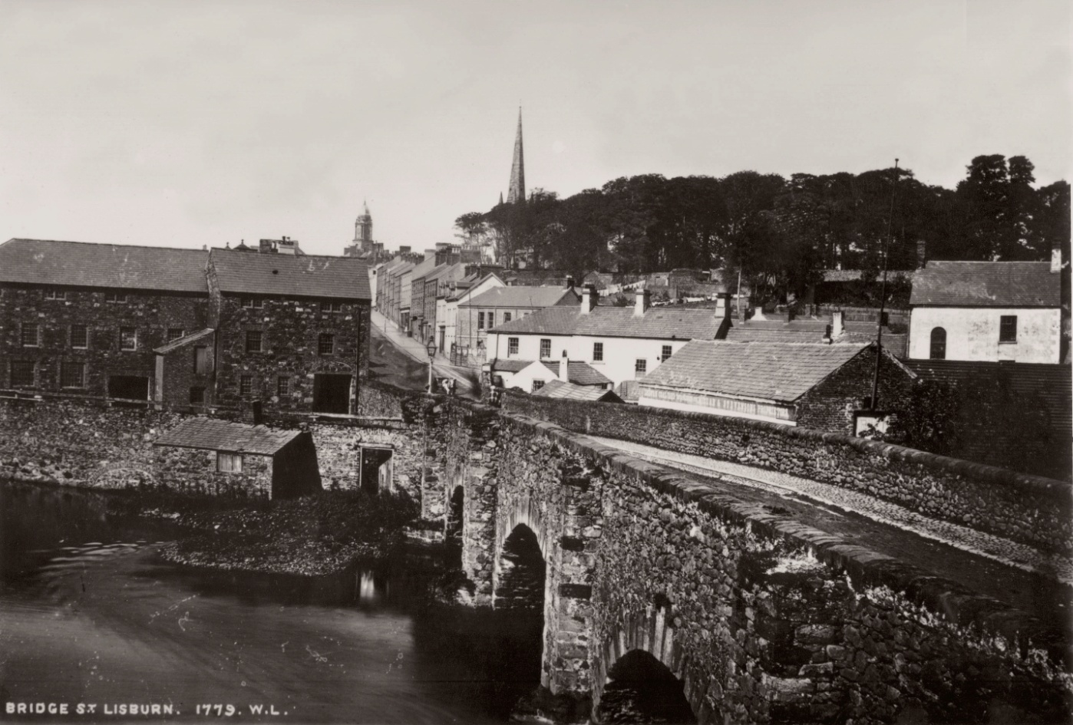
The Original Bridge
This is a photo of the original stone bridge of Lisburn erected in 1785.
The spire of the cathedral can be seen in the distance behind the tree line

Slide 6
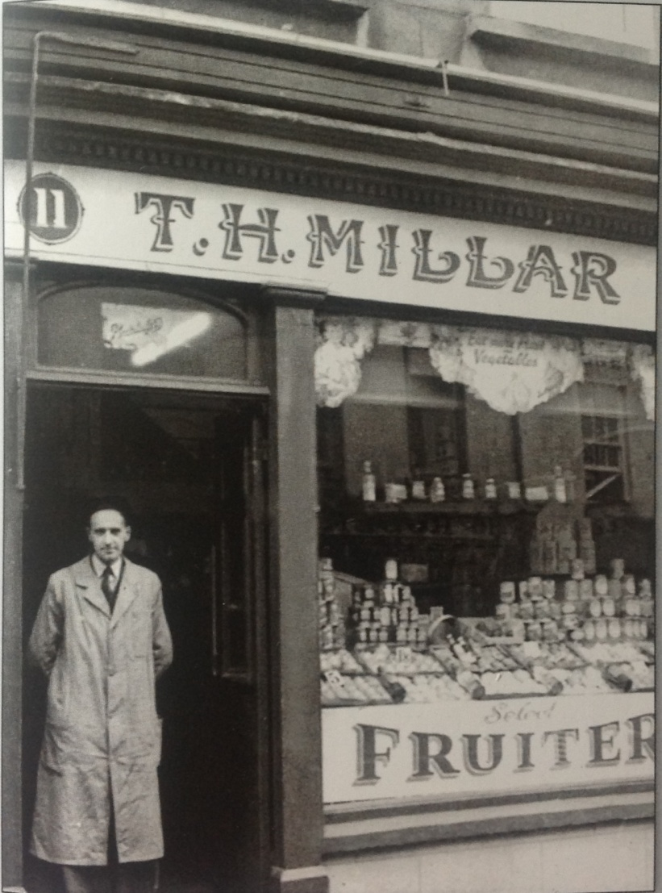
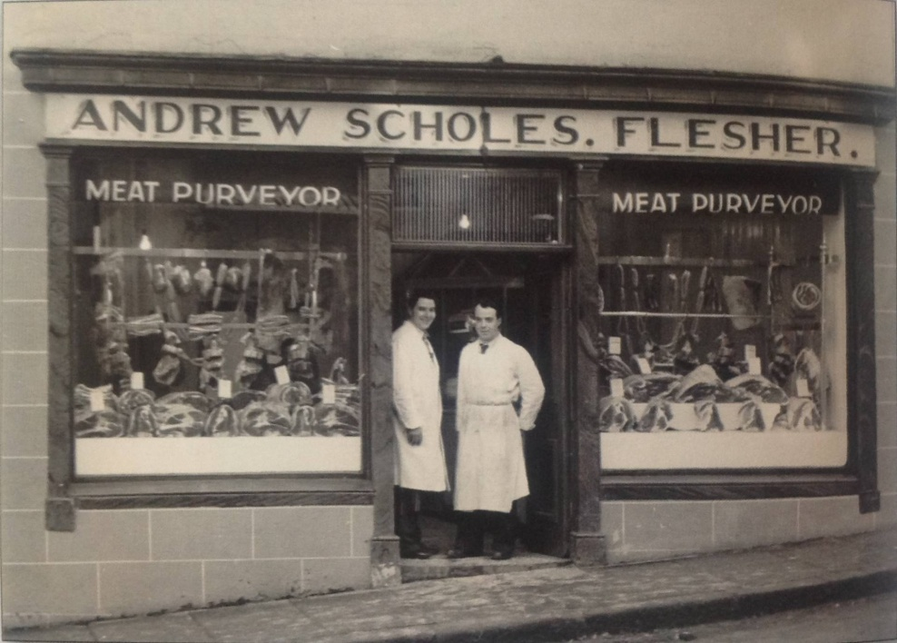
A Street of Business
Scholes’ Butcher’s shop
Businesses have been a key part of Bridge Street over the years. With many family shops running for generations.
Millar’s was one of the first shops to have a telephone.

Slide 7
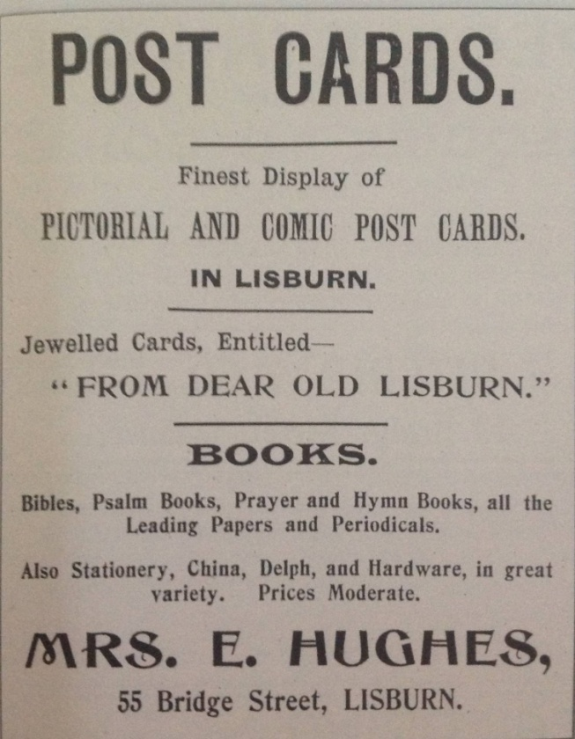
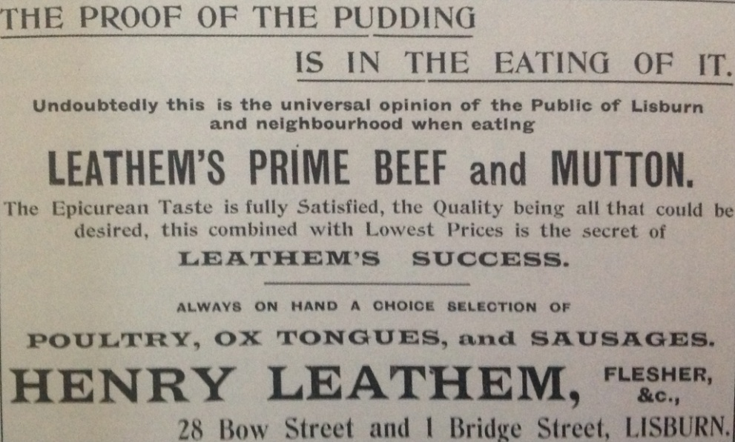
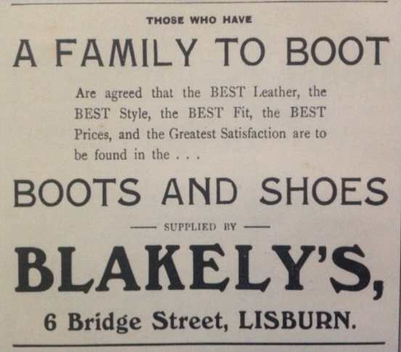
Advertising Bridge Street
Some examples of advertisements from shops on Bridge Street

Slide 8
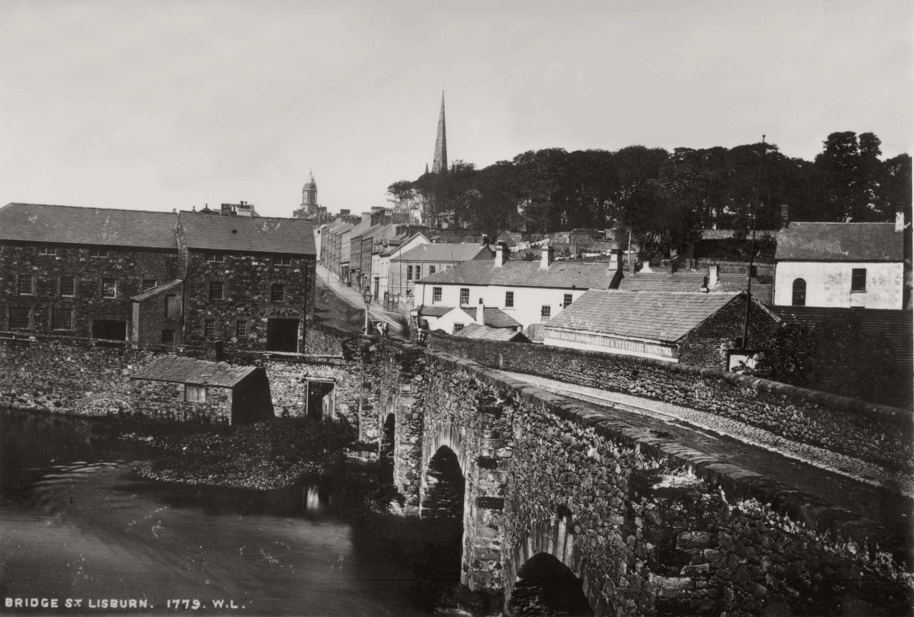
How Bridge Street has Changed
1885

Slide 9
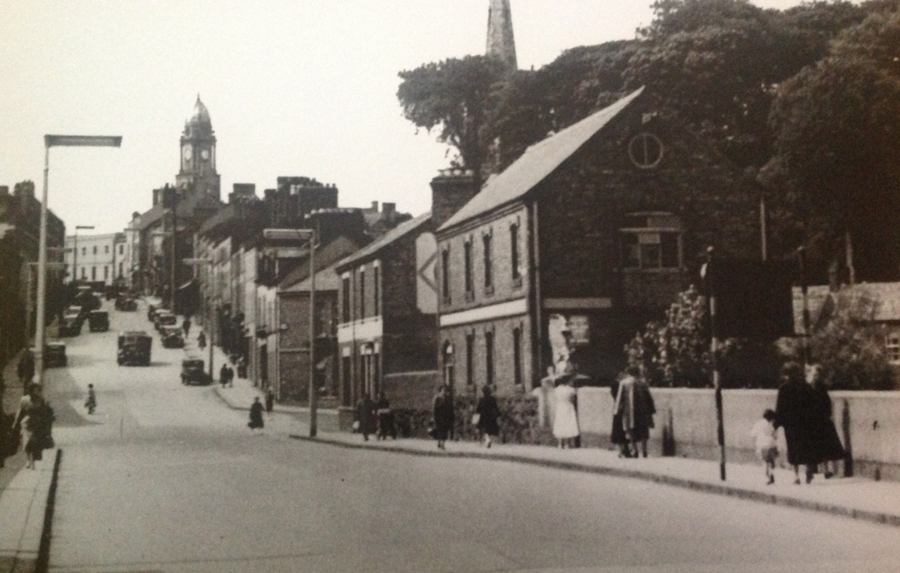
How Bridge Street has Changed
1950

Slide 10
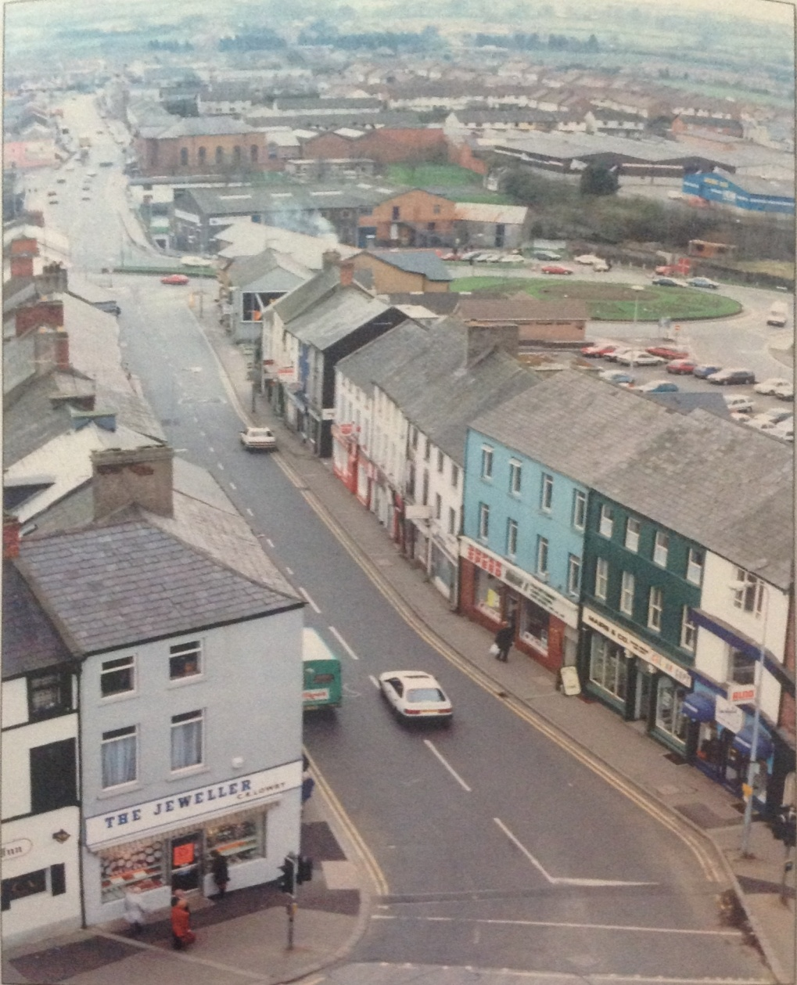
How Bridge Street has Changed
1993

Slide 11
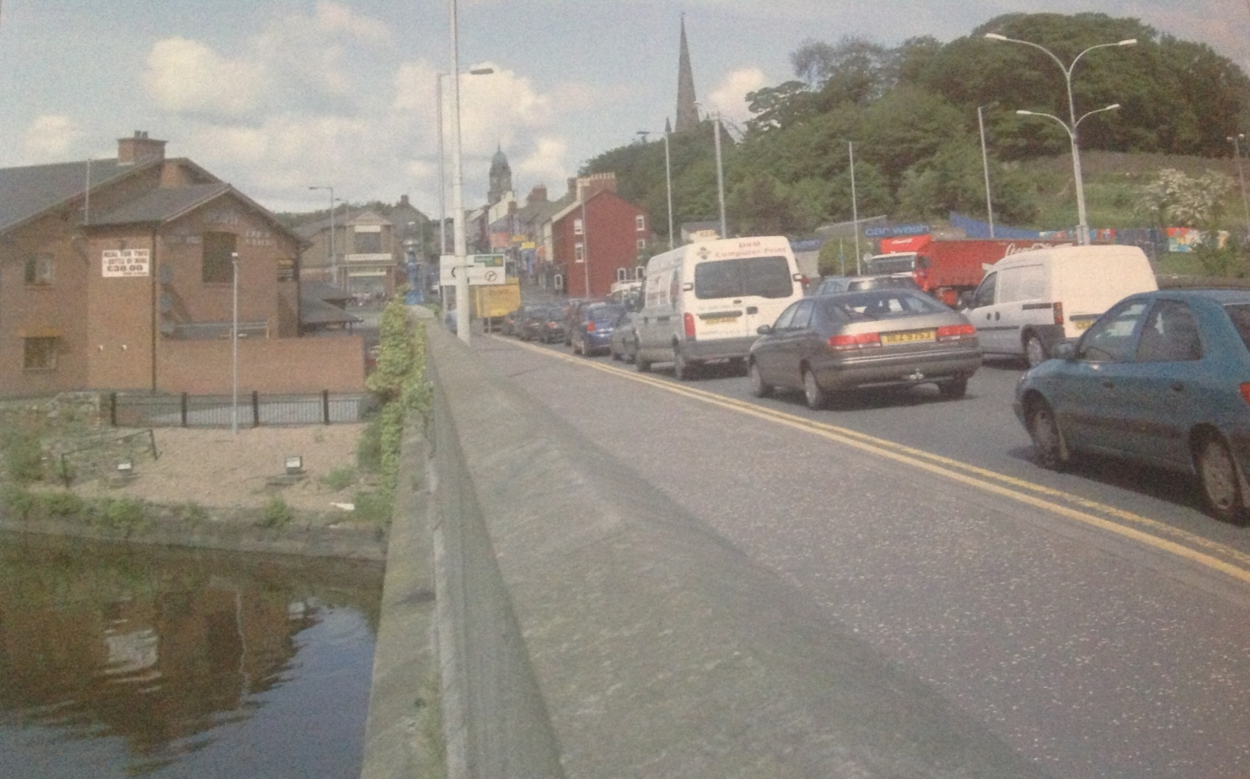
How Bridge Street has Changed
2006

Slide 12
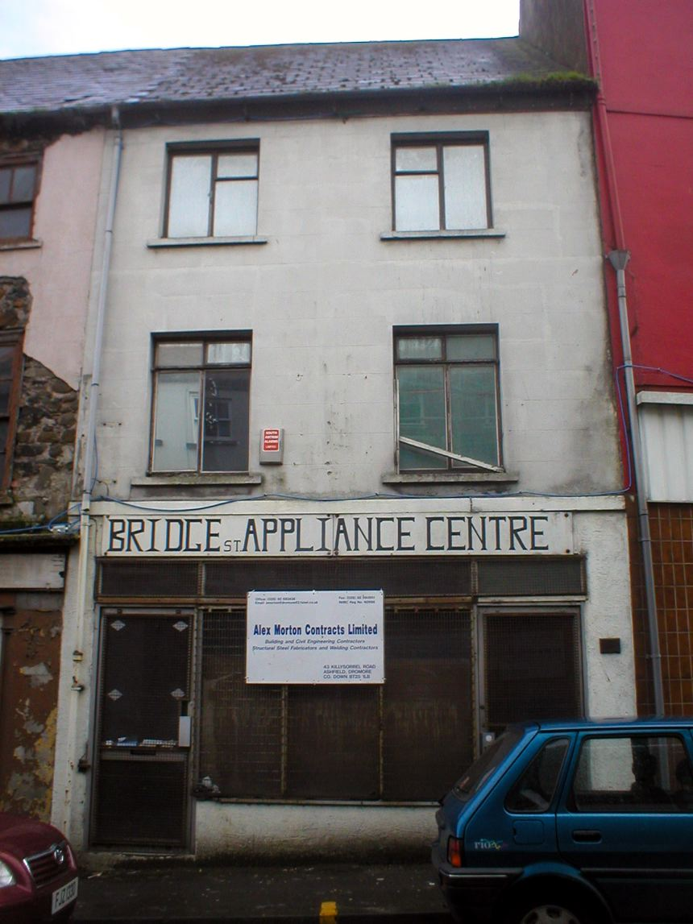
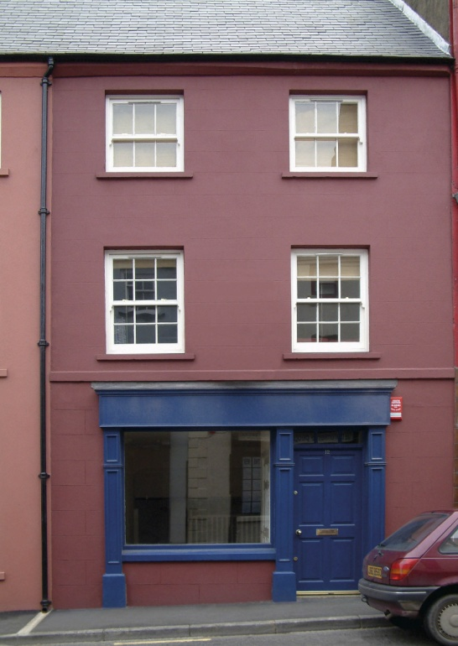
The Townscape Heritage Initiative
The Townscape Heritage Initiative (THI) is the Heritage Lottery Fund's grant giving programme for the repair and regeneration of the historic environment in towns and cities throughout the UK.
The scheme was born of the HLF's desire to deliver sustainable conservation in historic urban areas by raising the standard of repair where the market has failed to do so, and by bringing new uses.
12 Bridge Street Before and After

Slide 13
The Townscape Heritage Initiative
The THI programme encourages partnerships of local organisations to carry out repairs and other works to a number of historic buildings, structures or spaces within defined areas to aid social and economic regeneration and help to improve the quality of life for all those who live, work or visit there.

Slide 14
www.laganvalleylearning.co.uk

